Slide 1
Cryptocurrency Trading Platform Project Team 12 Machida Hiroaki

Slide 2
Contents
About Project
ERD
Logical Design
Physical Design
Demo Queries
Stored Procedure
Conclusion

Slide 3



Cryptocurrency exchange platform that customers can exchange real currencies and cryptocurrency
About Project
Business:
A cryptocurrency exchange platform that users can exchange money for cryptocurrency, and vice versa.
Exchange platform
Use case:
# | Use case
1 | A user opens an account.
2 | The user deposits money.
3 | The user places an order.
4 | The order is settled.
5 | The user withdraws cryptocurrency.

Slide 4
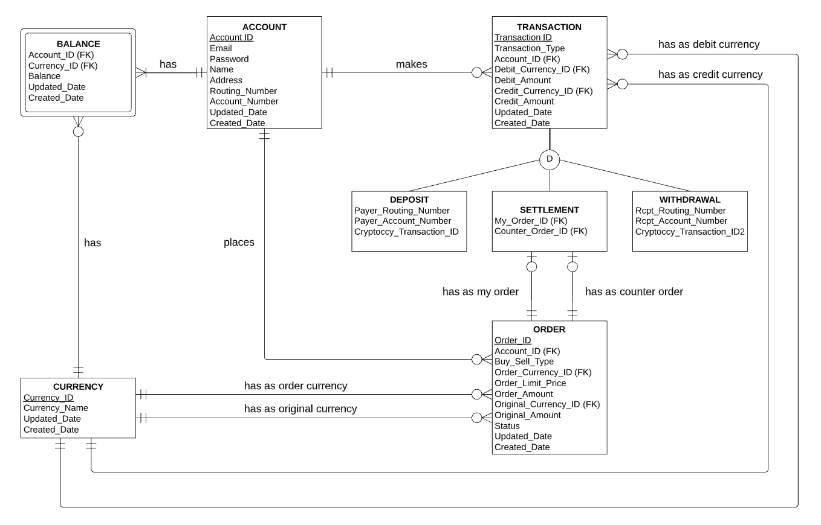
Account places orders and when it’s settled, transaction will be generated
ERD

Slide 5
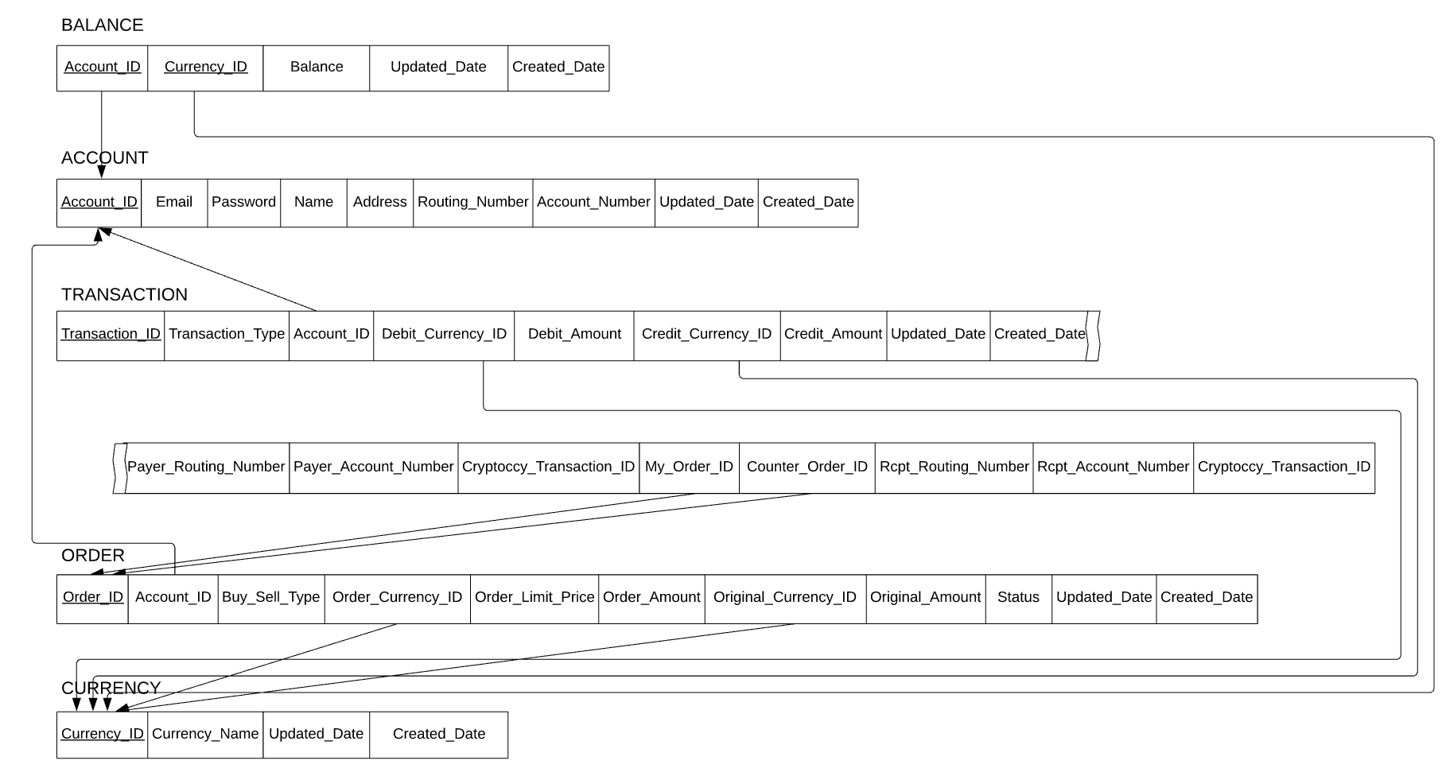
Transaction is divided into deposit, settlement and withdraw by transaction_type
Logical Design

Slide 6
Physical design is created based on the logical design
Physical Design
CREATE TABLE "ACCOUNT"
( "ACCOUNT_ID" VARCHAR2(20) NOT NULL,
"EMAIL" VARCHAR2(200) NOT NULL,
"PASSWORD" VARCHAR2(30) NOT NULL,
"NAME" VARCHAR2(100) NOT NULL,
"ADDRESS" VARCHAR2(200) NOT NULL,
"ROUTING_NUMBER" VARCHAR2(9) NOT NULL,
"ACCOUNT_NUMBER" VARCHAR2(12) NOT NULL,
"UPDATED_DATE" DATE NOT NULL,
"CREATED_DATE" DATE NOT NULL,
CONSTRAINT "ACCOUNT_PK" PRIMARY KEY ("ACCOUNT_ID")
);
CREATE TABLE "CURRENCY"
( "CURRENCY_ID" VARCHAR2(20) NOT NULL,
"CURRENCY_NAME" VARCHAR2(20) NOT NULL,
"UPDATED_DATE" DATE NOT NULL,
"CREATED_DATE" DATE NOT NULL,
CONSTRAINT "CURRENCY_PK" PRIMARY KEY ("CURRENCY_ID")
);
CREATE TABLE "BALANCE"
( "ACCOUNT_ID" VARCHAR2(20) NOT NULL,
"CURRENCY_ID" VARCHAR2(20) NOT NULL,
"BALANCE" NUMBER NOT NULL,
"UPDATED_DATE" DATE NOT NULL,
"CREATED_DATE" DATE NOT NULL,
CONSTRAINT "BALANCE_FK1" FOREIGN KEY ("ACCOUNT_ID")
REFERENCES "ACCOUNT" ("ACCOUNT_ID"),
CONSTRAINT "BALANCE_FK2" FOREIGN KEY ("CURRENCY_ID")
REFERENCES "CURRENCY" ("CURRENCY_ID")
) ;
CREATE TABLE "ORDER_"
( "ORDER_ID" VARCHAR2(20) NOT NULL,
"ACCOUNT_ID" VARCHAR2(20) NOT NULL,
"BUY_SELL_TYPE" VARCHAR2(4) NOT NULL,
"ORDER_CURRENCY_ID" VARCHAR2(20) NOT NULL,
"ORDER_LIMIT_PRICE" NUMBER NOT NULL,
"ORDER_AMOUNT" NUMBER NOT NULL,
"ORIGINAL_CURRENCY_ID" VARCHAR2(20) NOT NULL,
"ORIGINAL_AMOUNT" NUMBER NOT NULL,
"STATUS" VARCHAR2(10) NOT NULL,
"UPDATED_DATE" DATE NOT NULL,
"CREATED_DATE" DATE NOT NULL,
CONSTRAINT "ORDER_PK" PRIMARY KEY ("ORDER_ID"),
CONSTRAINT "ORDER__FK1" FOREIGN KEY ("ACCOUNT_ID")
REFERENCES "ACCOUNT" ("ACCOUNT_ID"),
CONSTRAINT "ORDER__FK2" FOREIGN KEY ("ORDER_CURRENCY_ID")
REFERENCES "CURRENCY" ("CURRENCY_ID"),
CONSTRAINT "ORDER__FK3" FOREIGN KEY ("ORIGINAL_CURRENCY_ID")
REFERENCES "CURRENCY" ("CURRENCY_ID")
);
CREATE TABLE "TRANSACTION"
( "TRANSACTION_ID" VARCHAR2(20) NOT NULL,
"TRANSACTION_TYPE" VARCHAR2(10) NOT NULL,
"ACCOUNT_ID" VARCHAR2(20) NOT NULL,
"DEBIT_CURRENCY_ID" VARCHAR2(20) NOT NULL,
"DEBIT_AMOUNT" NUMBER NOT NULL,
"CREDIT_CURRENCY_ID" VARCHAR2(20) NOT NULL,
"CREDIT_AMOUNT" NUMBER NOT NULL,
"UPDATED_DATE" DATE NOT NULL,
"CREATED_DATE" DATE NOT NULL,
"PAYER_ROUTING_NUMBER" VARCHAR2(9),
"PAYER_ACCOUNT_NUMBER" VARCHAR2(12),
"CRYPTOCCY_TRANSACTION_ID" VARCHAR2(34),
"MY_ORDER_ID" VARCHAR2(20),
"COUNTER_ORDER_ID" VARCHAR2(20),
"RCPT_ROUTING_NUMBER" VARCHAR2(9),
"RCPT_ACCOUNT_NUMBER" VARCHAR2(12),
"CRYPTOCCY_TRANSACTION_ID2" VARCHAR2(64),
CONSTRAINT "TRANSACTION_PK" PRIMARY KEY ("TRANSACTION_ID"),
CONSTRAINT "TRANSACTION_FK1" FOREIGN KEY ("ACCOUNT_ID")
REFERENCES "ACCOUNT" ("ACCOUNT_ID"),
CONSTRAINT "TRANSACTION_FK2" FOREIGN KEY ("DEBIT_CURRENCY_ID")
REFERENCES "CURRENCY" ("CURRENCY_ID"),
CONSTRAINT "TRANSACTION_FK3" FOREIGN KEY ("CREDIT_CURRENCY_ID")
REFERENCES "CURRENCY" ("CURRENCY_ID"),
CONSTRAINT "TRANSACTION_FK4" FOREIGN KEY ("MY_ORDER_ID")
REFERENCES "ORDER_" ("ORDER_ID"),
CONSTRAINT "TRANSACTION_FK5" FOREIGN KEY ("COUNTER_ORDER_ID")
REFERENCES "ORDER_" ("ORDER_ID")
);

Slide 7
Create an account and balances by each currency
Demo Queries: A user opens an account
# | Use case
1 | A user opens an account.
2 | The user deposits money.
3 | The user places an order.
4 | The order is settled.
5 | The user withdraws cryptocurrency.
--A user opens an account.
INSERT INTO ACCOUNT VALUES('21', 'uaubri0@cyberchimps.com', 'NLHokv0', 'Ursuline Aubri', '9866 Ridgeview Junction', '236105411', '341000165174', sysdate, sysdate);
INSERT INTO BALANCE VALUES('21', '1' ,0, sysdate, sysdate);
INSERT INTO BALANCE VALUES('21', '2' ,0, sysdate, sysdate);
INSERT INTO BALANCE VALUES('21', '3' ,0, sysdate, sysdate);
COMMIT;

Slide 8
Get a current balance, create a transaction and update the current balance
Demo Queries: The user deposits money
# | Use case
1 | A user opens an account.
2 | The user deposits money.
3 | The user places an order.
4 | The order is settled.
5 | The user withdraws cryptocurrency.
--The user deposits money.
SELECT * FROM BALANCE WHERE ACCOUNT_ID = '21' and (CURRENCY_ID = '1' OR CURRENCY_ID = '2');
INSERT INTO TRANSACTION VALUES('11', 'DEPOSIT', '21', '2', 0, '2', 10000, sysdate, sysdate, '236105411', '341000165174', null, null, null, null, null, null);
UPDATE BALANCE SET BALANCE=10000, UPDATED_DATE = sysdate, where ACCOUNT_ID = '21' and CURRENCY_ID = '2';
COMMIT;

Slide 9
Get the current balance and create an order
Demo Queries: The user places an order
# | Use case
1 | A user opens an account.
2 | The user deposits money.
3 | The user places an order.
4 | The order is settled.
5 | The user withdraws cryptocurrency.
--The user places an order.
SELECT * FROM ORDER_ WHERE ORDER_CURRENCY_ID = '1' and ORIGINAL_CURRENCY_ID = '2' and STATUS = 'ACTIVE';
INSERT INTO ORDER_ VALUES('12', '21', 'BUY', '1', 7100, 0.1, '2', 710, 'ACTIVE', sysdate, sysdate);
COMMIT;

Slide 10
Another order placed, mark orders as settled, create transactions and update balances
Demo Queries: The order is settled
# | Use case
1 | A user opens an account.
2 | The user deposits money.
3 | The user places an order.
4 | The order is settled.
5 | The user withdraws cryptocurrency.
--The order is settled.
SELECT * FROM ORDER_ WHERE ORDER_CURRENCY_ID = '1' and ORIGINAL_CURRENCY_ID = '2' and STATUS = 'ACTIVE';
INSERT INTO ORDER_ VALUES('13', '1', 'SELL', '1', 7100, 0.1, '2', 710, 'SETTLED', sysdate, sysdate);
UPDATE ORDER_ SET STATUS = 'SETTLED', UPDATED_DATE = sysdate WHERE ORDER_ID = '12';
INSERT INTO TRANSACTION VALUES('12', 'SETTLEMENT', '21', '2', 7100, '1', 0.1, sysdate, sysdate, null, null, null, '12', '13', null, null, null);
INSERT INTO TRANSACTION VALUES('13', 'SETTLEMENT', '1', '1', 0.1, '2', 7100, sysdate, sysdate, null, null, null, '13', '12', null, null, null);
SELECT * FROM BALANCE WHERE ACCOUNT_ID = '21' and (CURRENCY_ID = '1' OR CURRENCY_ID = '2');
SELECT * FROM BALANCE WHERE ACCOUNT_ID = '1' and (CURRENCY_ID = '1' OR CURRENCY_ID = '2');
UPDATE BALANCE SET BALANCE = 0.1, UPDATED_DATE = sysdate WHERE ACCOUNT_ID = '21' and CURRENCY_ID = '1';
UPDATE BALANCE SET BALANCE = 2900, UPDATED_DATE = sysdate WHERE ACCOUNT_ID = '21' and CURRENCY_ID = '2';
UPDATE BALANCE SET BALANCE = 666124.9, UPDATED_DATE = sysdate WHERE ACCOUNT_ID = '1' and CURRENCY_ID = '1';
UPDATE BALANCE SET BALANCE = 913351, UPDATED_DATE = sysdate WHERE ACCOUNT_ID = '1' and CURRENCY_ID = '2';
COMMIT;

Slide 11
Get the current balance, update it and create a transaction
Demo Queries: The user withdraws cryptocurrency
# | Use case
1 | A user opens an account.
2 | The user deposits money.
3 | The user places an order.
4 | The order is settled.
5 | The user withdraws cryptocurrency.
--The user withdraws cryptocurrency.
SELECT * FROM BALANCE WHERE ACCOUNT_ID = '21' and CURRENCY_ID = '1';
UPDATE BALANCE SET BALANCE = 0, UPDATED_DATE = sysdate WHERE ACCOUNT_ID = '21' and CURRENCY_ID = '1';
INSERT INTO TRANSACTION VALUES('14', 'WITHDRAW', '21', '1', 0.1, '1', 0, sysdate, sysdate, null, null, null, null, null, null, null, '18MnkkPLjQZJiZvQbjcUbrx56LCkRyXFXP');
COMMIT;

Slide 12
Get every user’s balance as a cursor, then update the balance
Stored Procedure: add bitcoin to every user
create or replace PROCEDURE bitcoin_campaign (btc IN NUMBER, r OUT VARCHAR2)
IS
CURSOR c1 IS SELECT ACCOUNT_ID, BALANCE FROM BALANCE WHERE CURRENCY_ID = '1';
BEGIN
DBMS_OUTPUT.PUT_LINE('..start..');
FOR rec IN c1 LOOP
UPDATE BALANCE SET BALANCE = rec.BALANCE + btc, UPDATED_DATE = sysdate WHERE ACCOUNT_ID = rec.ACCOUNT_ID and CURRENCY_ID = '1';
END LOOP;
DBMS_OUTPUT.PUT_LINE('..end..');
r := 'OK';
EXCEPTION
WHEN others THEN
DBMS_OUTPUT.PUT_LINE('..error..');
r := 'NG';
END
;

Slide 13
Making a procedure from scratch was new to me
Conclusion
What did you learn?
I learned how to make procedures from scratch.
What did you have to change in midstream?
I had to change several minor mistakes on the design phase, such as wrong foreign keys, and a subtype specifier.
What would you do differently if you could restart?
I would add user session.

